Slide 1
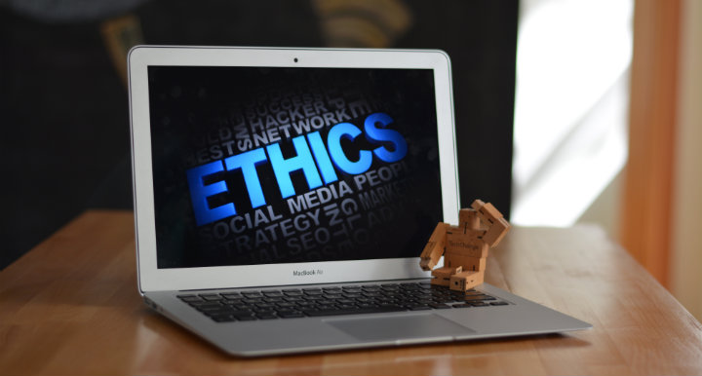
Law, Ethics, and Social Responsibility BTE 620

Slide 2
Agenda
Introductions
Class policies
Student evaluation
TENTATIVE Weekly Schedule
Current issues in Ethics and IT

Slide 3
Professor Xavier Scott
PhD in Philosophy from York University;
Taught at York University, Ryerson University, and the University of Hargeisa (Somaliland);
Studies law, politics, ethics, religion, and mass media;
Apps: E-mail, Reuters, CBC News.
E-mail: xavier.scott@senecacollege.ca
Blackboard: You will be e-mailed once the blackboard website is set up.
Office Location: TBA

Slide 4
Introduction Cards
Name (what you want Xavier to call you)
Degree Program
Favorite class at Seneca so far
Favorite TV show/movie/book
Favorite phone app

Slide 5
Class Policies
Attendance: You are not graded on attendance, but please sign in on Tuesdays to help with record keeping.
Extensions: Extensions can be requested in advance for the same number of days as the request is made before the due date. (e.g. If an essay is due January 25th and a student requests an extension on January 18th they may have a 7 day extension. If they request an extension on January 24th they may have a 1 day extension). Extensions must be requested through e-mail.
E-mail: The fastest way to reach me will be at my Seneca e-mail Xavier.scott@senecacollege.ca. I will check my e-mail as regularly as possible. I will try to get back to you in 1-2 business days.
Readings: You are expected to have done the readings prior to lecture and to have a copy of them with you in class.

Slide 6
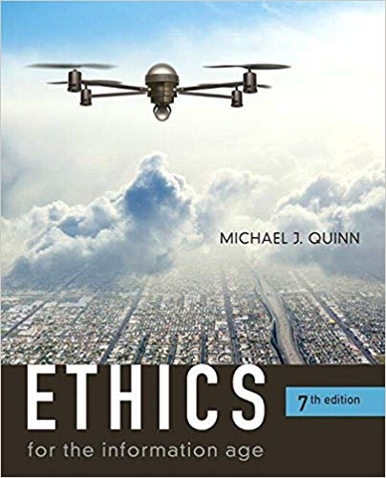
Textbook

Slide 7
Evaluation
Assignment | Due Date | Grade Weight
Ethical Theory Test | January 24th | 10%
IT and Me assignment | February 21st | 15%
Midterm | March 7th | 15%
Weekly Quiz x10 | Weekly on Thursdays (see schedule) | 10%
Critical Essay | March 28th | 20%
Final Exam | Exam Week (Date TBA) | 30%

Slide 8
TENTATIVE (Not Final) Weekly Schedule 1-4
Week | Topic | Readings
1 Jan. 8 & 10 | Introductions | Quinn, Chapter 1
2 Jan. 15 & 17 | Ethics introduced I | Quinn, Chapter 2 | Quiz 1 (Chapter 2)
3 Jan. 22 & 24 | Ethics Introduced II | Quinn, Chapter 2 continued | Ethics Test
4 Jan. 31 & Feb. 2 | Networked Communication | Quinn, Chapter 3 | Quiz 2 (chapter 3)

Slide 9
TENTATIVE (Not Final) Weekly Schedule 5-7
Week | Topic | Readings
5 Feb. 7 & 9 | Intellectual Property | Quinn, Chapter 4 | Quiz 3 (chapter 4)
6 Feb. 14 & 16 | Information Privacy | Quinn, Chapter 5 | Quiz 4 (chapter 5)
7 Feb. 21 & 23 | Privacy and Government | Quinn, Chapter 6 | IT and Me assignment due Feb. 21 & Quiz 5 (chapter 6)
Feb. 25-Mar. 1 | Study Week

Slide 10
TENTATIVE (Not Final) Weekly Schedule 8-11
Week | Topic | Readings
8 Mar. 5&7 | Review and Midterm | Review | Midterm
9 Mar. 12 & 14 | Computer and Network Security | Quinn, Chapter 7 | Quiz 6 (chapter 7)
10 Mar. 19 & 21 | Computer Reliability | Quinn, Chapter 8 | Quiz 7 (chapter 8)
11 Mar. 26 & 28 | Professional Ethics | Quinn, Chapter 9 | Quiz 8 (chapter 9)

Slide 11
TENTATIVE (Not Final) Weekly Schedule 12-14
Week | Topic | Readings
12 Apr. 2 & 4 | Work and Wealth | Quinn, Chapter 10 | Critical essay due April 2nd & Quiz 9 (Chapter 10)
13 Apr. 9 & 11 | Fake News & Review | Allcott and Gentzkow, 2017. See Blackboard for a copy of the article. | Quiz 10 (Allcott and Gentzkow Article)
14 | Exam Week |  | Exam (Date TBA)

Slide 12
Seneca Policy on Academic honesty
The policy states “Engaging in any form of academic dishonesty to obtain any type of academic advantage or credit is an offence under this policy and will not be tolerated by the college.”
Section 9, Academic Honesty, Academic Policy: http://www.senecacollege.ca/academic-policy/acpol-09.html
Academic Honesty Forms:
http://www.senecacollege.ca/academic-policy/forms.html
SICT Academic Honesty clarification:
https://ict.senecacollege.ca/students/academic-honesty-policy
Notes:
Engaging in any form of academic dishonesty to obtain any type of academic advantage or credit is an offence under this policy and will not be tolerated by the college.

Slide 13
Ethical Issues
Why study the ethics of information technology?
What issues come to mind?

Slide 14
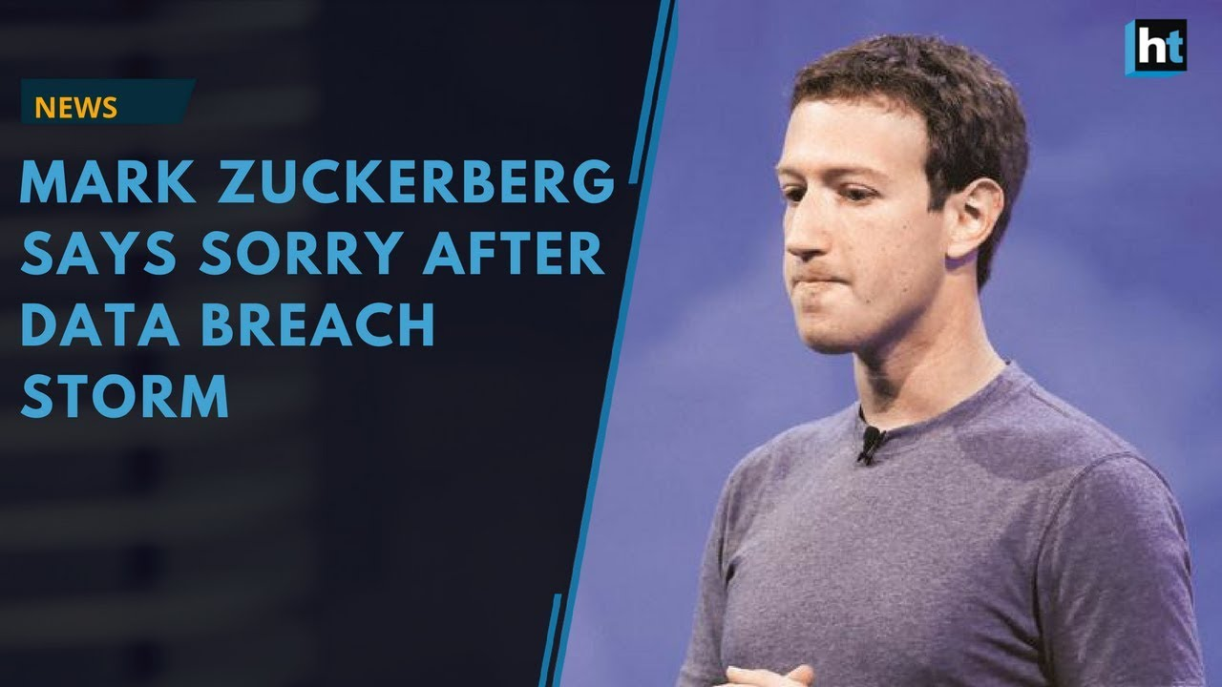
Goal: Don’t end up on the news apologizing.
Tech companies are under increased scrutiny.
Mark Zuckerberg was recently forced to apologize to Congress after it was revealed that Facebook gave the user data of millions of users to Cambridge Analytica, who then used that information to manipulate the 2016 US election.

Slide 15
Tech Companies
In 2010, only 35% of US adults owned a smart phone, today 68% do – with 86% of those 18-29 owning one (O’Brien & Szeman 2018).
Tech companies often rely on an unregulated markets and exporting manufacturing costs for their profits. Silicon Valley humorously portrays this in their depiction of Gavin Bellson.
Cellphones, due to their reliance on expensive minerals, satellites, and server space – have a much higher environmental impact than many realize (currently creating 1.5% of Greenhouse gases, but slated to rise in the future).

Slide 16
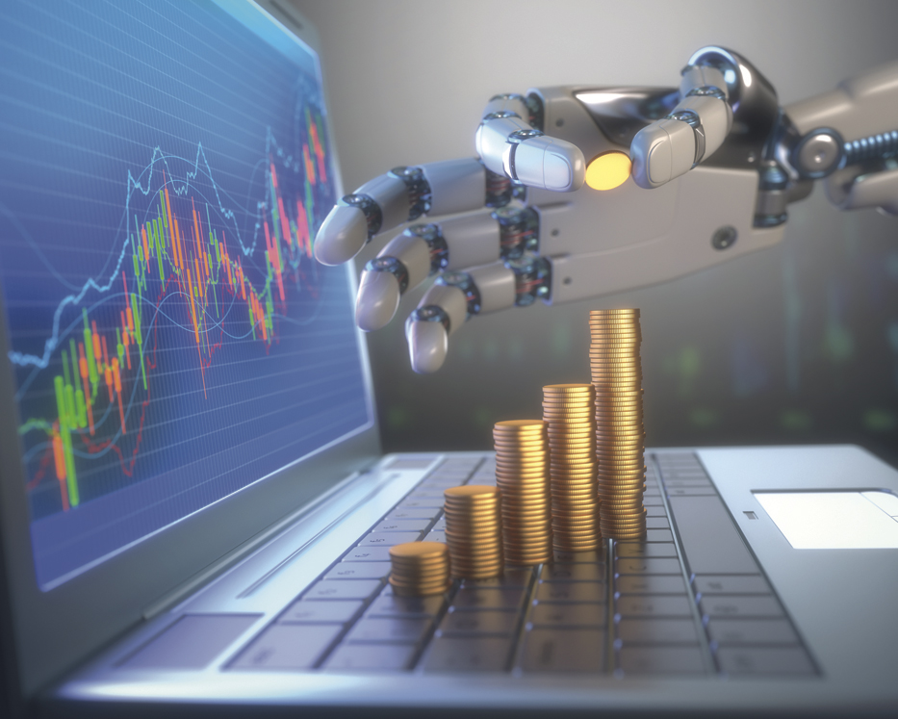
Tech and the Economy
Tech companies are some of the most profitable in the world. The four most valuable corporations in the world are: Apple ($1T), Amazon ($860B), Microsoft ($833B), and Alphabet ($765B).
Technology is often less regulated as an industry to encourage innovation. For example, Uber doesn’t want to be a taxi company (minimum wage, lots of local regulations, etc.). Facebook doesn’t want to be regulated as a content creator (responsible for liable laws and accurate reporting). Uber Eats doesn’t want its delivery people to be considered employees (who get insurance benefits), but rather independent contractors.

Slide 17

Internet Piracy
Owners of IP: internet piracy is a crime and it deprives artists and producers of income.
Sharers of IP: artists are frequently not the beneficiaries of the price paid for content. Only large, transnational corporations benefit from buying content legitimately. Also, IP actually stifles innovation, by preventing people from using information to create new content and products.

Slide 18
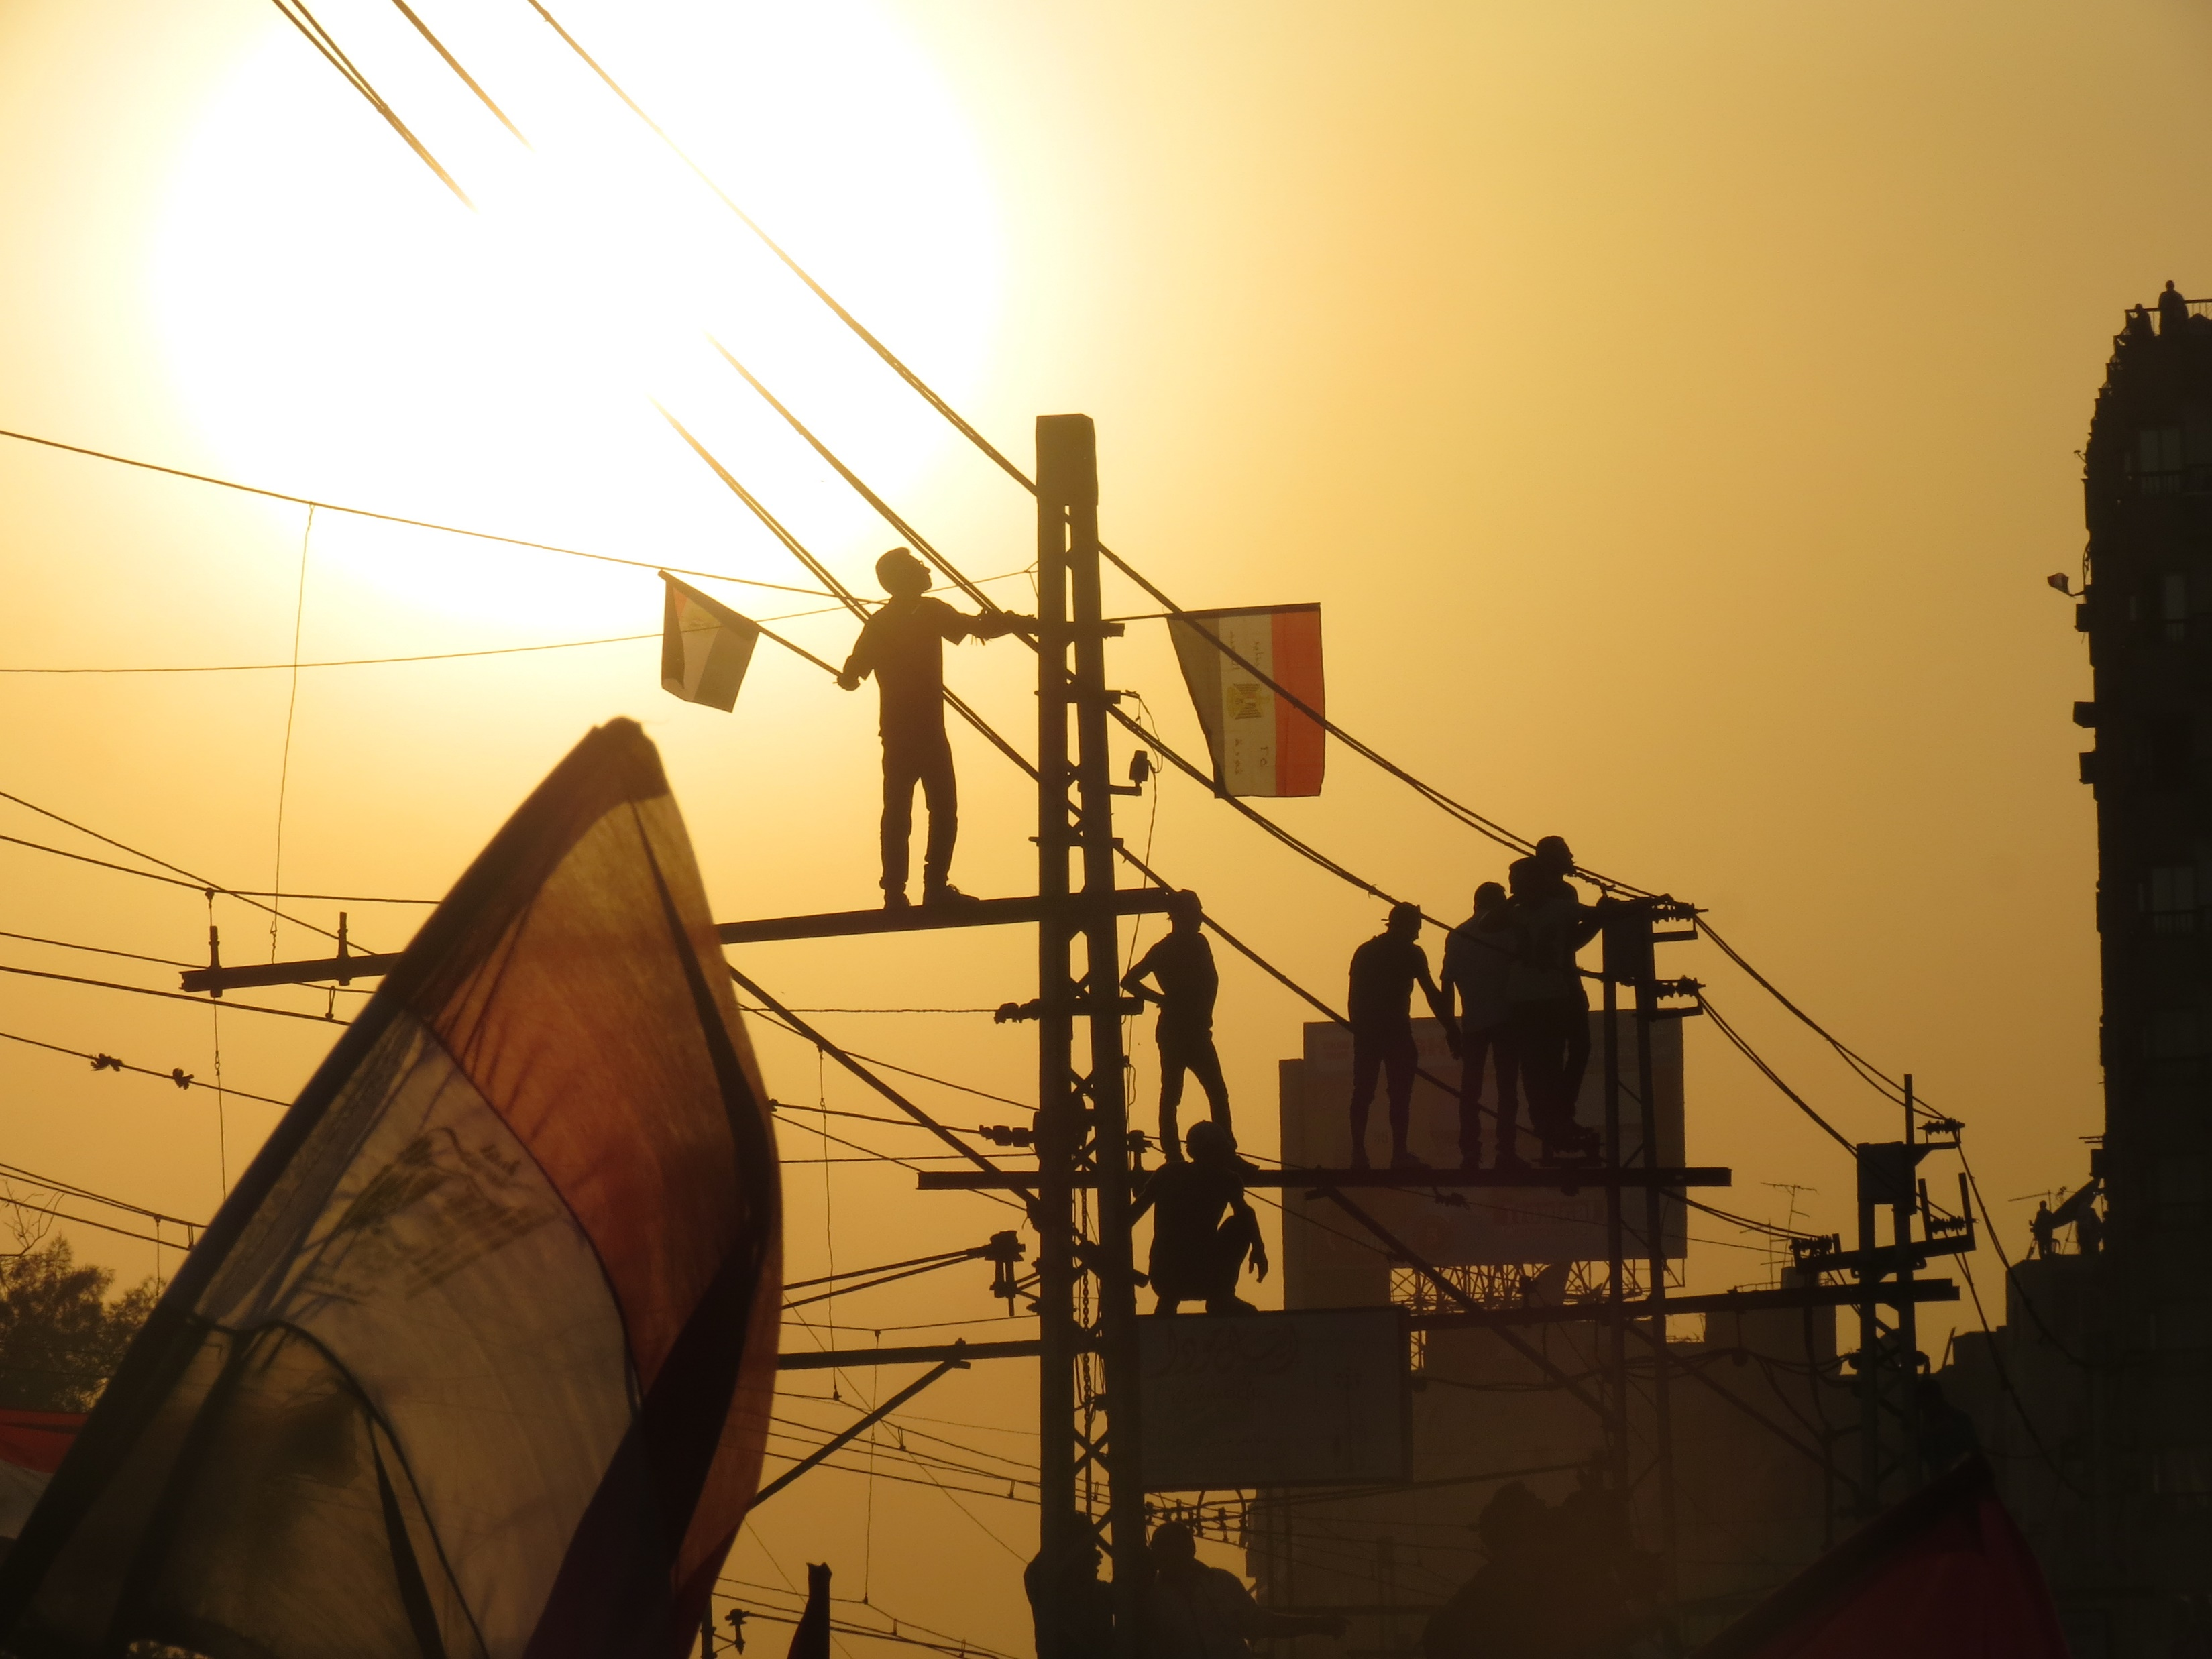
Digital Disruption
Two events took place that refocused the potential of social media to affect politics: Arab Spring and Occupy Wallstreet.
Arab Spring:
Longstanding governments fell: Egypt’s Hosni Mubarak (30 years); Tunisia’s Ben Ali (20 years); Muammar Gaddafi (42 years); Ali Abdulluh Saleh (27 years).
Social media was used to spread the story of Mohammed Bouazizi, who set himself on fire to protest the arbitrary seizing of his vegetable stand by police over failure to obtain a permit; it was also used to spread the story of Egyptian, Khaled Saeed, who was beaten to death by police in Alexandria.

Slide 19

Screen Addiction
Dr. Nicholas Kardaras (2016), one of the country's top addiction experts, details how compulsive technology usage and reliance on screens can neurologically damage the developing brain of a child the same way that drug addiction can.
Screens have been linked to increased ADHD, depression, and anxiety.
Do you think society will develop fixes for this in the future?

Slide 20
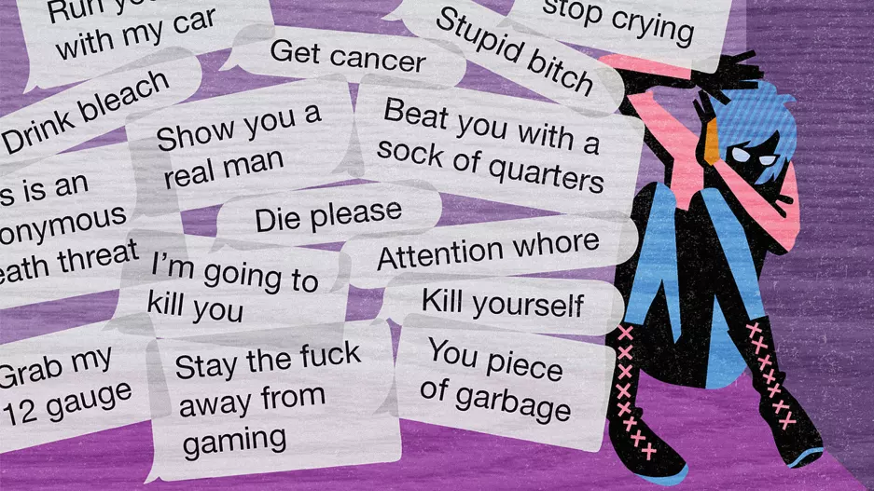
Online Harassment
Social media has made it easier to connect with people and to get news out, but it has also made people more vulnerable to harassment online.
High profile suicides, such as those by Amanda Todd (2012) and Rehtea Parsons (2013) have encouraged public action to stop online ‘bullying’.

Slide 21
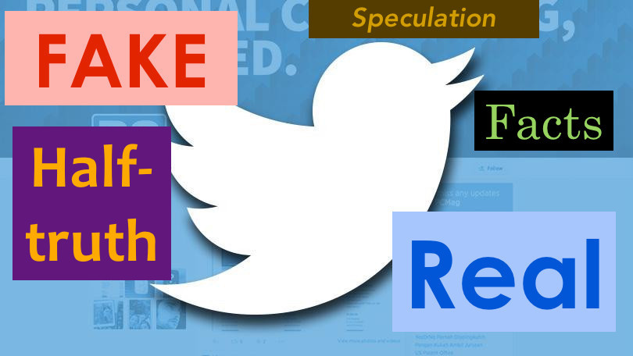
Social Media and Fake News
Social media platforms are conducive to fake news for several reasons:
The cost of creating content and putting it out there are minute.
The format of social media (small bit of information – often viewed on a phone) makes it harder to spot fakes.
Facebook friend networks are ideologically segregated (median share of friends with the opposite ideology is only 20% for liberals, 18% for conservatives).

Slide 22
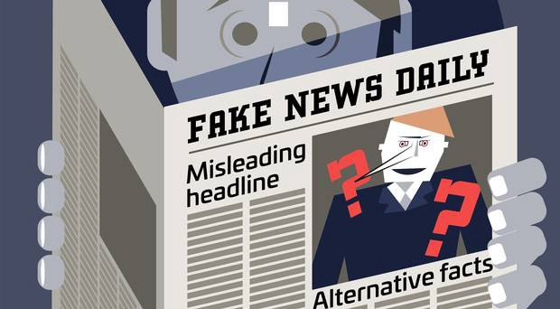
Social Costs of Fake News
Consumers who mistake fake news for real news have less accurate beliefs.
Less accurate beliefs cause social problems (e.g. democratic selection of inferior candidates).
Consumers become skeptical of legitimate news outlets.
Reduced demand for accuracy in reporting will reduce the incentive of news outlets to invest in accuracy.

